Slide 1
No ‘comp’romised LEARNING
By Marquicha Green

Slide 2
Description
My project is a program that incorporates computer science learning into the already established curriculum throughout inner city public schools.
Notes:
The program will incorporate many of the lessons that are described in the in the Pennsylvania Learning Standard for Early Education for Kindergarten. (There would many different versions of this program by grade level but this protype will focus on kindergarten students.)
The protype version of this program will include sections 1.1 Foundational Skill, 2.1 Numbers and Operations, 2.2 Algebraic Concepts, 2.4 Measurement, Data and Probability, and 15.4 Computer and Information Technology from the Pennsylvania Learning Standard for Early Education for Kindergarten.

Slide 3
Main Strengths
Exposure to computer science learning in early in the educational career of many students
Easy and convenient to deploy for educators
An overall seamless, creative, effective way to have students open to the endless possibilities that a career in the tech industry can offer

Slide 4



Primary Development Environment

Slide 5
Overview of Project Design
As an implementation of this program, there would be a computerized lesson that will teach kindergarten students how to analyze data. The data analyzation will move through five steps:

Slide 6
Overview of Project Design
Identify the data that is to be analyzed / Defining questions or goals
The goal could be something as novice: Put all the like colors or shapes together.
1
Collect the data / data to be used
For simplicity there would be objects of likeness ranging for 2-20.
2
Clean the data / removing outliers
For simplicity there would be object(s) that our outliers.
3
Analyze
Students will analyze the data. There will be a series of questions ask to the students about the data sets.
4
Interpretation of results / creating data visualizations
The data will be display in many different charts for the student to see.
5

Slide 7
Overview of Project Design
The program will be an interactive story time style that will be appealing to the grade level of the student(s).
The student will ultimately have to organize a set of objects; There would the options of having the student organize objects by color and shape. The number of comparable sets are set to increase as the student completes the lesson ranging from 2-10. Each set will contain a different number of objects ranging from 2-20.
When student completes a level, they will move up a level.

Slide 8
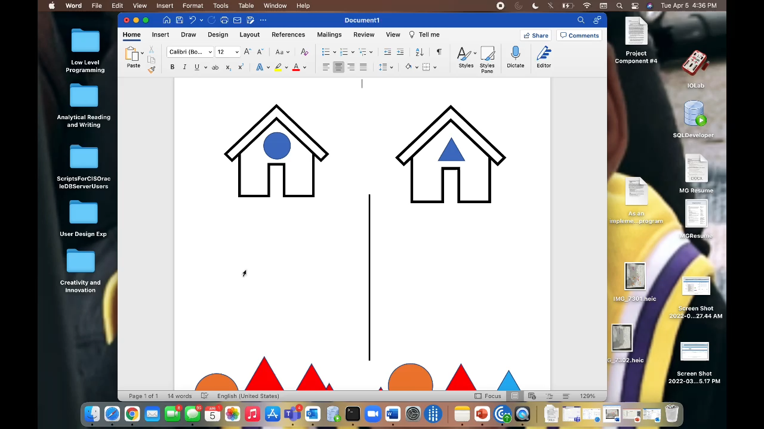
Intermediate Prototype Demonstration

Slide 9
Final Prototype
Final Demo / Prototype

